Slide 1
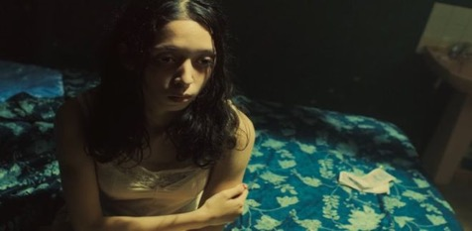
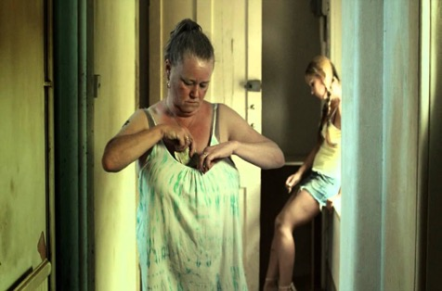
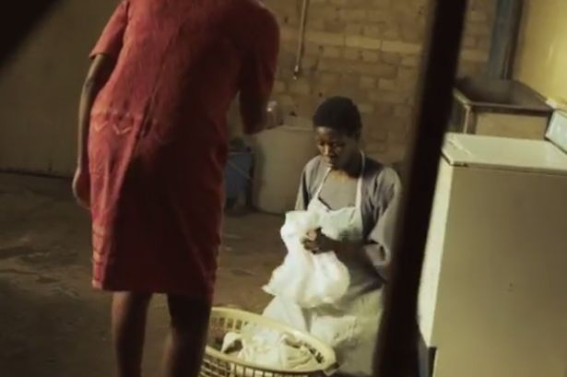
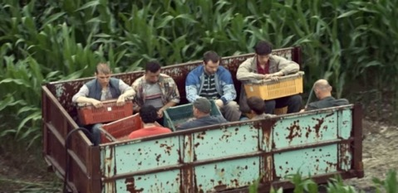
UK Modern Slavery Awareness
Tier 3
Unlock your Learning ( Awareness)

Slide 2

AIMS & OBJECTIVES
To raise awareness of modern slavery and human trafficking ;
To understand role and responsibilities in tackling modern slavery;
To understand how you can contribute to fighting modern slavery in the UK;
To understand what support is available for modern slavery victims.

Slide 3

ACTIVITY
Discuss, in your groups which definition matches the category :
Smuggled
Trafficked
Asylum Seeker
Refugee
Migrant Worker
UK Modern Slavery Training
Delivery Group
Notes:
Use the bubbles material provided or use flipchart to get the groups to consider the 4 definitions
Inform delegates that trafficked victims can be British and could include county lines teenagers

Slide 4

WHAT DO YOU KNOW ABOUT
MODERN SLAVERY?
Notes:
The most simple explanation for ‘slavery’. Despite being outlawed on both sides of the Atlantic, the trade in human slaves has not stopped. It has simply been driven ‘underground’ by being prohibited. America and UK brought out legislation in 1807 on the exploitation of human beings but it wasn't in force until 1808 with the UK continuing slave trade with the Caribbean's until 1811
Modern Slavery Act 2015 is an Act of the UK parliament designed to tackle slavery in the UK and consolidates previous offences relating to trafficking and slavery . The act extends to England and Wales which received Royal Assent on 26 march 2015
Modern slavery includes: human trafficking, slavery, servitude, forced & compulsory labour
Human trafficking is the fastest growing form of slavery today and is prohibited under international law, as well as under the criminal laws of the United Kingdom and other countries.
The home office estimated in 2013 there were between 10,000 & 13,000 victims of modern slavery in UK

Slide 5

TYPES OF EXPLOITATION
There are several broad categories linked to Modern Slavery
ALL prioritise profit over people.
Sexual Exploitation
Forced Labour
Forced Criminality
Domestic Servitude
Organ Harvesting
Child Exploitation
Did you know?
5145 potential victims submitted to NRM - Labour exploitation is the most recorded form of slavery in the UK of recorded NRM cases (NCA, 2017)
Notes:
Sexual - frequently through prostitution where victims are placed into off-street brothels, forced to see many clients, or online and receive either little or no money.
Forced labour - where victims are forced to work very long hours and hand over all of their wages to their traffickers or controllers, e.g. domestic situations as sweatshop factories, construction sites, farm work, paving/ tarmacking, manufacturing, food processing, hospitality
Criminal – drugs, cannabis farming, organised crime, begging, benefit fraud, shoplifting/Theft, Credit card/ATM fraud, Selling Stolen Goods, DVD Pirating and Sales, pick pocketing
Domestic Servitude - victims who live and work in households where they are forced to work through threats of serious harm and physical and sexual assaults, ill treated, humiliated, long hours, unbearable conditions for little or no pay.
Organ harvesting - where victims are trafficked in order to sell their body parts and organs for transplant; eggs, kidneys, liver, eyes (China)
Children - children are amongst the most vulnerable victims; sometimes they are sold into forced labour or domestic work through debt bondage by family members where they are vulnerable to sexual or physical abuse.

Slide 6

THREE KEY WORDS
Palermo Protocol to the United Nations Convention against Transnational Organised Crime (2000)
ACT
MEANS
PURPOSE
Notes:
The Protocol to Prevent, Suppress and Punish Trafficking in Persons, especially Women and Children (also referred to as the Trafficking Protocol or UN TIP Protocol) is a protocol to the Convention against Transnational Organised Crime. It is one of the three Palermo protocols, the others being the Protocol against the Smuggling of Migrants by Land, Sea and Air and the Protocol against the Illicit Manufacturing and Trafficking in Firearms.
The protocol was adopted by the United Nations General Assembly in 2000 and entered into force on 25 December 2003. As of September 2016 it has been ratified by 170 parties.^{[1]}
Palermo Protocol can be provided on a handout (full definitions)
Trainer should explain that whilst the definition is long and wordy, it has been simplified to 3 key words – Act, Means and Purpose.

Slide 7
HUMAN TRAFFICKING
(Palermo Protocol)
THE ACT
(What is done)
THE MEANS
(How it is done)
THE PURPOSE
(Why it is done)
Recruit,
Transport,
Transfer,
Harbour or Receipt of Persons
Threat or use of force or other forms of coercion
Abduction
Fraud / Deception
Abuse of power or of a position of vulnerability
Giving or receiving of payments or benefits to achieve the consent of a person having control over another person
*The MEANS is not pertinent for under 18 year olds
Sexual exploitation; forced labour or services
Slavery or practices similar to slavery
Servitude, or
the removal of organs.
UK Modern Slavery Training
Delivery Group
Notes:
Talk through the slides giving examples for each point.
Explain that the Act, Means and Purpose must be present for a referral into the NRM for an adult trafficked person. Recruitment OR Transport or Transfer etc could be present – not all the list are required
The NRM will be explained in more detail later in the presentation
But good to outline now that the The National Referral Mechanism (NRM) is a framework for identifying victims of human trafficking or modern slavery and ensuring they receive the appropriate support
Full Palermo protocol:
"Trafficking in persons" shall mean the recruitment, transportation, transfer, harbouring or receipt of persons, by means of the threat or use of force or other forms of coercion, of abduction, of fraud, of deception, of the abuse of power or of a position of vulnerability or of the giving or receiving of payments or benefits to achieve the consent of a person having control over another person, for the purpose of exploitation. Exploitation shall include, at a minimum, the exploitation of the prostitution of others or other forms of sexual exploitation, forced labour or services, slavery or practices similar to slavery, servitude or the removal of organs;”
NOTE : trainers are to make it clear to delegates that the MEANS ( middle section ) of the definition is irrelevant when it involves children as children cannot consent to their own exploitation

Slide 8
Domestic Legal Framework: Modern Slavery Act 2015
Became an Act 26th of March 2015
Extends to England and Wales
Consolidates previous offenses relating to trafficking and slavery
Two new civil orders to prevent slavery
Establishes an Anti-Slavery Commissioner
Increases sentences to life imprisonment
Perpetrators face the toughest asset confiscation
Statutory defence for victims to prevent criminalisation
Strengthen law enforcement powers at sea
© International Organization for Migration (IOM), 2016. All rights reserved. No part of this material may be reproduced or transmitted, in any form or by any means, without prior written permission from IOM.
Notes:
NB: Previous legislation:
In England, Wales and Northern Ireland, the primary criminal legislation relevant to trafficking is the Sexual Offences Act 2003 (Sections 57, 58 and 59 create three offences of trafficking with the intention of committing a relevant sexual offence on the trafficked person, including rape, prostitution, sexual abuse and all child sex offences)
For non-sexual exploitation, the primary legislation for the United Kingdom is the Asylum and Immigration Act 2004. Non-sexual exploitation includes domestic servitude or forced labour, human organ donation or forcing or enabling another person to acquire a benefit.
In addition, the Coroners and Justice Act 2009 creates an offence of holding another person in slavery or servitude or requiring them to perform forced or compulsory labour
Prevention orders – ie. prevent an individual participating in business, working with children, travelling to a certain country, visiting a certain place etc.
Key changes in this legislation is that consent of the individual is irrelevant, more forms of exploitation are included and vulnerabilities of the VoT are considered
The intention behind the crime is key – up to 10 years imprisonment for this alone

Slide 9
Some useful information…
Modern Slavery Act 2015
Section 2 – Human Trafficking
Trafficking in persons has three constituent elements
The Act
The Means
The Purpose
Trafficking
Recruitment,
Transport,
Transfer,
Harbouring,
Or receipt of persons
Threat
Coercion
Abduction
Fraud
Deception
Payment
Exploitation
Penalty – Life imprisonment on indictment
Notes:
For children the MEANS does NOT need to be proved
The NRM process for a child is
NRm provision for children is …

Slide 10
ACTIVITY
Discuss, in the context of your role in your organisation, how you would recognise:
The signs/indicators of a victim of Modern Slavery;
The barriers that would prevent a potential victim of Modern Slavery coming forward / seeking help.
UK Modern Slavery Training
Delivery Group
Notes:
Tell the group to split their flipchart paper into 2 columns: Child Adult
Show the following slides to ensure they have covered everything
Indicators both physical & emotional
Health – physical, emotional & mental
The barriers that would stop a victim telling us what is happening to them.
A handout to be given to cover indicators.

Slide 11




SIGNS & INDICATORS
Having no personal identification or passport/documents held by someone else
Lack of money/control over own finances or excessive wage reductions
Living/sleeping in place of work
Evidence of control of movement either as an individual or a group
Limited contact with family and/or limited social contact
Others seeking to speak for the person you are trying to engage with
Living or found in ‘degrading’ conditions
Multiple occupancy living accommodation
UK Modern Slavery Training
Delivery Group
Notes:
Trainers to mention that the list is not exhaustive
Victims may not be aware of their rights to social protection in the UK – there is a minimum wage/ health and safety protection
No passports or papers – traffickers are wise to this now and making sure they have false documents.
No days off or holiday time & imposed work conditions
Being restricted from freely leaving work
Appearing anxious/nervous around ‘Family Member’ or ‘Interpreter’
Employer providing transportation to/from work daily
Threats against family members
Signs of physical abuse
Excessive response Perception of being debt bonded

Slide 12

SIGNS & INDICATORS
Children not in education
Children living with non-relevant families or relationship between child and adult unclear
Signs of branding/ ownership
Perception of being in debt to someone
Injuries apparently as a result of assault or ill treatment, as a result of work, or from restraints such as shackles or rope
Limited access to medical or dental care
Fearful of police or authority figures
Evidence of fear towards a dominant male or female (fear, shying away, overly suggestive)
Lifestyles they cannot afford e.g. new mobile, clothes, money etc.
UK Modern Slavery Training
Delivery Group
Notes:
Trainers to mention that the list is not exhaustive
For young people being internally trafficked remember: Expensive lifestyles, e.g. new mobile, clothes, money, food, etc.
Older boyfriends (5 years plus)

Slide 13
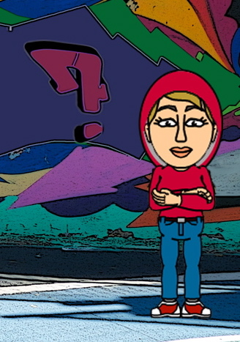
Children Signs and Indicators
Missing overnight
Significantly older ‘boyfriend’
Meeting in person people first ‘met’ online
In/out vehicles driven by unknown/ concerning adults
Exchanging sex for drugs, alcohol, money, etc.
Frequenting areas known for sex work/ CSE hot spots
Peers involved in CSE
Disclosure followed by withdrawal
Unexplained money/clothes/ items
Coercion, control, or emotional abuse by the older ‘boyfriend’
Coerced into sexual acts
Physical assault by the older ‘boyfriend’
Notes:
This list is not exhaustive
The list reflects exploitation of boys and girls ie : british boys being exploited by ‘ boyfriends ‘

Slide 14
Children Signs and Indicators
Exclusion/ absence/ not engaging with school
Living independently & not keeping in touch
Alcohol misuse
Drug misuse
STIs/ pregnancy/ termination/ believed to be sexually active
Expressions of despair
Multiple callers
Victim of sexual assault
Staying out beyond permitted time
Concerning use of mobile
Concerning use of internet
Multiple social network account in different identities
Sharing/ receiving indecent images

Slide 15

BARRIERS TO DISCLOSING
Lack of awareness that they are a victim
Unaware that help is available
Language barriers
Controlled movement
Fear of repercussions (to themselves or family)
Always accompanied by trafficker
Isolation
Feel they are better off in current situation than previous one
Immigration status
Involvement in criminal activity
Juju (witchcraft)
Lack of trust in authorities
Self-blame
Stigma
‘Stockholm Syndrome’
UK Modern Slavery Training
Delivery Group
Notes:
Stockholm syndrome, or capture–bonding, is a psychological phenomenon in which hostages express empathy and sympathy and have positive feelings toward their captors, sometimes to the point of defending them. These feelings are generally considered irrational in light of the danger or risk endured by the victims, who essentially mistake a lack of abuse from their captors for an act of kindness.
Stockholm syndrome can be seen as a form of traumatic bonding, which describes “strong emotional ties that develop between two persons where one person intermittently harasses, beats, threatens, abuses, or intimidates the other
It suggests that the bonding is the individual’s response to trauma in becoming a victim. Identifying with the aggressor is one way that the ego defends itself. When a victim believes the same values as the aggressor, they cease to be a threat.
Inform delegates that there are organizations that provide support and assistance to victims
highlight that victims are unlikely to open up or likely to be inconsistent at the start due to their trauma and experience.
It is vital to highlight that even if an individual’s account seems farfetched and impossible, not to disbelieve or disregard them. it’s vital to stress that if an individual has a support worker that individuals should utilise the support worker as much as possible as they have developed a working relationship with them and it’s likely that they will have information that the client will not disclose to a stranger despite consenting to having shared the information.

Slide 16
ACTIVITY
Discuss, in your groups
What might make children and adults vulnerable to being pulled in to slavery?
How are they recruited?
Where/ how might you find victims of slavery being exploited in the UK?
UK Modern Slavery Training
Delivery Group
Notes:
Tell the group to split their flipchart paper into 3 columns:
In other words what “pushes” them into the trafficking world?
What makes it easy for them to be recruited? What pulls them in to trafficking
The list of where you might find a victim is endless so we haven’t done a slide for this.
Show the following 2 slides to ensure they have covered all the push & pull factors.
Where / how might you find victims – everywhere
Examples are
Brothels
Nail bars
Farms
Private homes
Traveller sites
Hospitality
Car washes
Factories
Ships
Cannabis farms

Slide 17
WHY ARE THEY VULNERABLE?
Vulnerability
Factors
Violence (inc harmful traditional practices)
Conflict or natural disaster
Poverty
Gender and
Equality Issues
Substance dependency
Slavery endemic in area
Demand for cheap labour
Family debt
Lack of
opportunity
Notes:
Push factors are ways in which victims are vulnerable and therefore encouraged into trafficking:
Mental or physical health issues
Coming from a history of domestic or other violence
lack of employment or education
Culture and societal norms
Lack of opportunity for legal migration
Forced displacement, such as through conflict and climatic events

Slide 18
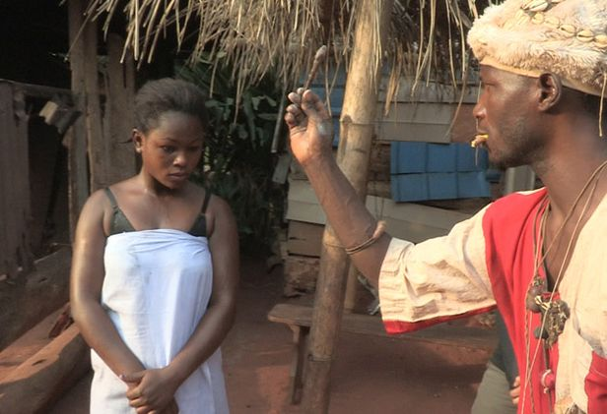
USE OF JUJU
The swearing of an oath
The ritual
Promise to repay debt and obey the ‘owner’
Breach of contract will bring ‘madness and death’
Ever-binding
Inhibits disclosure
Impacts on support.
Notes:
Anthony Harrison: Case highlighted the use of juju to control young victims
1st person to be convicted of trafficking people out of UK
Sentenced to 20 years for 4 counts of trafficking, 2 counts false imprisonment & Acquitted of 2 counts of rape
Convicted for trafficking victims out of the UK to Spain and Greece
2 Nigerian victims, aged 14 and 16
The two had been controlled by Juju magic rituals & were sold into prostitution with the help of the local Juju priest.
Juju is a significant part of West African culture.
Before coming to the UK, 1 girl was living with an uncle who was abusive & 1 had no family.
Harrison led a double life as a 'key player' in a people trafficking gang which used bizarre rituals to trap the children into sex slavery.
He arrived in the UK in April 2003, claiming to be Liberian, but evidence suggested he was actually from Nigeria.
Although his asylum application and subsequent appeals were refused, he was granted indefinite leave to remain under the Home Office 'Legacy' programme.
In 2009, Harrison oversaw the smuggling of the girls while he worked for Newham council.
Harrison then shipped them on to Spain and Greece to work in the sex industry.
It took police two years to persuade them to speak openly about their ordeal, such was the fear created by the ritual.
One victim fully believed she would die after appearing in court
Juju often known as magic or voodoo – often pieces of a person are taken & put in a jar e.g. hair, blood, nail clippings, etc.

Slide 19
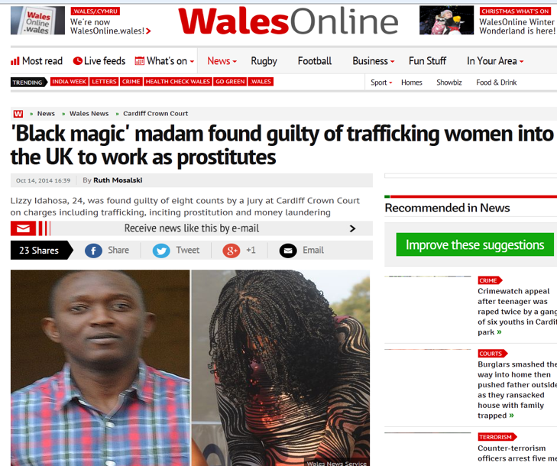
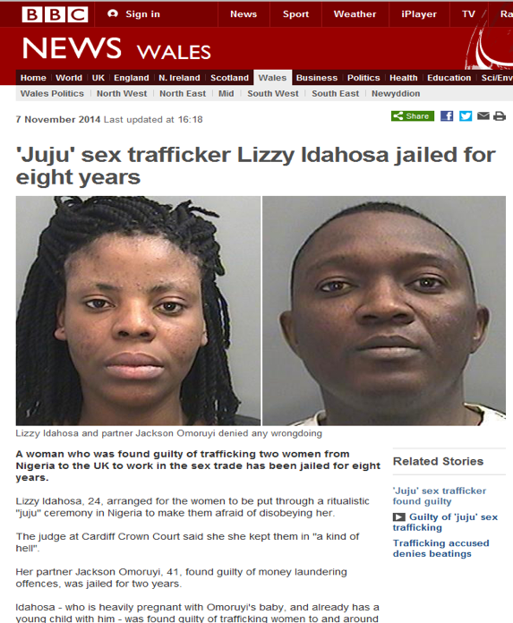
Notes:
http://www.walesonline.co.uk/news/wales-news/juju-court-case-people-trafficker-11005413
Juju' court case people trafficker Lizzy Idahosa told to pay back £21,000 or face nine more months in prison
A woman jailed for trafficking women into the UK and forcing them to work in the sex industry has been ordered to pay back more than £21,000.
Lizzy Idahosa, 26, was sentenced to eight years in prison at Cardiff Crown Court in November 2014 after being found guilty of trafficking Nigerian women into the UK for sexual exploitation.
On Friday, March 4, a confiscation order for £21,905 was granted at the same court after Immigration Enforcement financial investigators submitted an application under the Proceeds of Crime Act (POCA).
The judge ordered that the money be paid back within 28 days or a further nine month prison sentence will be imposed.

Slide 20
RECRUITMENT
Vulnerability
Factors
Employment
Support family back home
Better lifestyle
Improved social position in own country
Education
Love
Perceived safety
A Home
Expensive lifestyle
Notes:
Pull factors are complex factors that can fuel trafficking and make it easy for a trafficker to coerce a victim in to trafficking. It’s often something that the trafficker highlights is a need within the vulnerable person & therefore they use this as a way of pulling them in:
Employment & financial reward/benefit in developed countries
Perceptions of better lifestyle in developed countries
Opportunity to earn money and support family back home
Improved social position within own community
Promise of education
Employers demand for cheap labour/Consumers demand for cheap goods and services
Market gaps not filled by local labour supply
Being loved by someone
Feeling protected & safe
Provision of a roof over their head
An expensive lifestyle being provided which at some point will need to be repaid or services provided to sustain it.

Slide 21
Investigate and Rescue
NATIONAL REFERRAL MECHANISM
(NRM)
The NRM is a victim identification and support process which is designed to make it easier for all the different agencies that could be involved in a trafficking case – e.g. police, Home Office UK Visas and Immigration Directorate, local authorities, Health and Social Care (HSC) Trust in Northern Ireland, and non-governmental organisations (NGOs) – to co-operate; to share information about potential victims and facilitate their access to advice, accommodation and support.
IT PROVIDES:
Safe housing for a ‘reflection period’ – 45 days
Direct support
Repatriation support
UK Modern Slavery Training
Delivery Group
Notes:
The National Referral Mechanism (NRM) is a framework for identifying victims of human trafficking or modern slavery and ensuring they receive the appropriate support.
Adults MUST consent to being referred into the NRM. Children do NOT have to give consent. Children referred into the NRM are provided by local safeguarding arrangements -Early Adopter sites for Independent Child Trafficking Advocates provide a support service by Barnardos
The NRM is also the mechanism through which the Modern Slavery Human Trafficking Unit (MSHTU) collect data about victims. This information contributes to building a clearer picture about the scope of human trafficking and modern slavery in the UK.
The NRM was introduced in 2009 to meet the UK’s obligations under the Council of European Convention on Action against Trafficking in Human Beings. At the core of every country’s NRM is the process of locating and identifying “potential victims of trafficking”.
From 31 July 2015 the NRM was extended to all victims of modern slavery in England and Wales following the implementation of the Modern Slavery Act 2015.

Slide 22

Investigate and Rescue
NATIONAL REFERRAL MECHNAISM
DATA 2017
Sexual Exploitation 1185 (559)
Labour Exploitation 1326 (1026)
Unknown exploitation 144 (414)
Domestic Servitude 369 (119)
Organ Harvesting 3
(Children statistics bracketed) All figures from the National Crime Agency National referral Mechanism Summary Report 2016
UK Modern Slavery Training
Delivery Group
Notes:
REMIND – adults have to consent to take part in the NRM process.
5145 in total for the UK – a 35 % increase on 2016
Top 5 adult countries of origin =Albania/ Vietnam/ China / Nigeria/ Romania/ China
Top 5 Child countries of origin = UK , Albania/ Vietnam/ Sudan / Eritrea
Criminal – drugs, cannabis farming, organised crime, begging, benefit fraud
Organs – overies, kidneys, eyes
Unknown Exploitation means:
· The exploitation involved more than one category
· The exploitation category is not known

Slide 23
Investigate and Rescue
NATIONAL REFERRAL MECHNAISM
DATA 2017 – Top countries – Adult Referrals
Albania
Vietnam
China
Nigeria
Romania
China
(All figures from the National Crime Agency National referral Mechanism Summary Report 2017
UK Modern Slavery Training
Delivery Group
Notes:
REMIND – adults have to consent to take part in the NRM process.
5145 in total for the UK – a 35 % increase on 2016
Top 5 adult countries of origin =Albania/ Vietnam/ China / Nigeria/ Romania/ China
Top 5 Child countries of origin = UK , Albania/ Vietnam/ Sudan / Eritrea
Criminal – drugs, cannabis farming, organised crime, begging, benefit fraud
Organs – overies, kidneys, eyes

Slide 24
Investigate and Rescue
NATIONAL REFERRAL MECHNAISM
DATA 2017 – Top countries – Child Referrals
UK
Albania
Vietnam
Sudan
Eritrea
(All figures from the National Crime Agency National referral Mechanism Summary Report 2017
UK Modern Slavery Training
Delivery Group
Notes:
REMIND – adults have to consent to take part in the NRM process.
5145 in total for the UK – a 35 % increase on 2016
Top 5 adult countries of origin =Albania/ Vietnam/ China / Nigeria/ Romania/ China
Top 5 Child countries of origin = UK , Albania/ Vietnam/ Sudan / Eritrea
Criminal – drugs, cannabis farming, organised crime, begging, benefit fraud
Organs – overies, kidneys, eyes

Slide 25
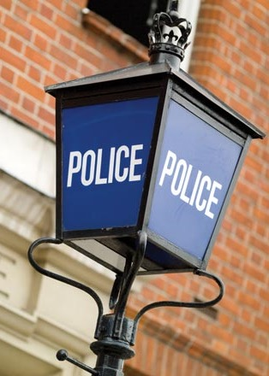
NRM – FIRST RESPONDERS
THE NCA IS A FIRST RESPONDER AGENCY, AS ARE THE FOLLOWING:
Police forces
UK Border Agency
Immigration and visas
Gangmasters Licencing Authority
Local Authorities
Salvation Army
Health and Social Care Trusts (NI)
Migrant Help
Medaille Trust
Kalavaan
Barnardo’s
Unseen
TARA Project (Scotland)
NSPCC (CTAC)
BAWSO
New Pathways
Refugee Council
Notes:
REMIND – adults have to consent to take part in the NRM process.
Remind delegates of the their role as First Responder
Provide overview to delegates re duty to notify – hand out duty to notify factsheet

Slide 26
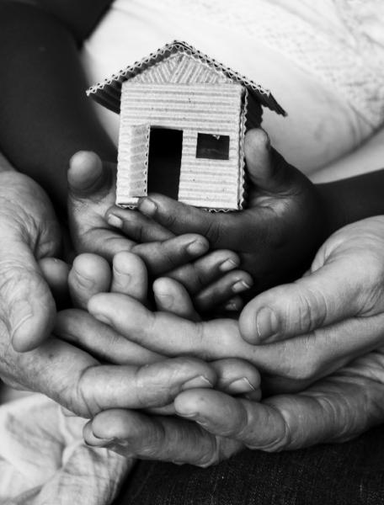
NRM PROVIDES
Investigate and Rescue
The NRM contract is provided by The Salvation Army in England. It provides:
Safe housing (minimum of 2 hours away) for men and women
Legal Advice
Health care (including alcohol/drug rehabilitation)
Counselling
Educational opportunities (including language training)
Repatriation assistance
The NRM provision is provided by BAWSO in Wales, TARA or Migrant Helpline in Scotland and Migrant Helpline or Women’s Aid in Northern Ireland.
Notes:
Inform delegates that the provision is for men and women only
Children are supported by local authority child safeguarding procedures

Slide 27
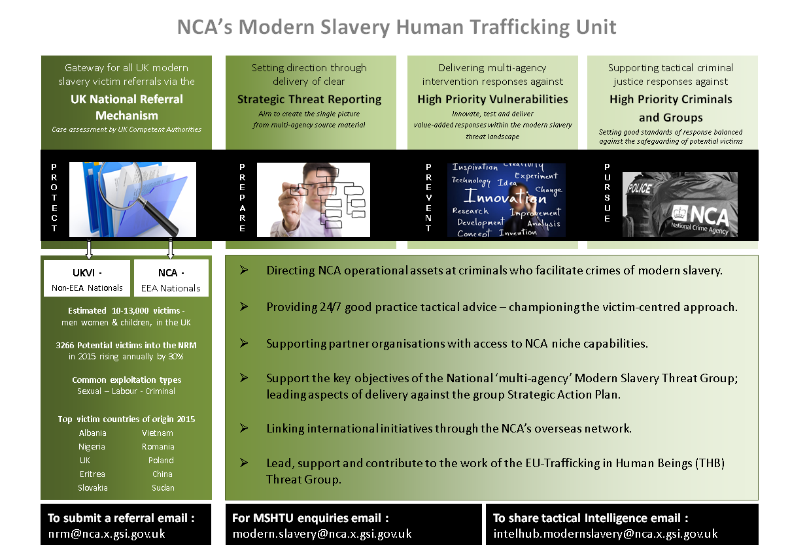
OFFICIAL-SENSITIVE
OFFICIAL-SENSITIVE
Notes:
Explain the role of the MSHTC

Slide 28
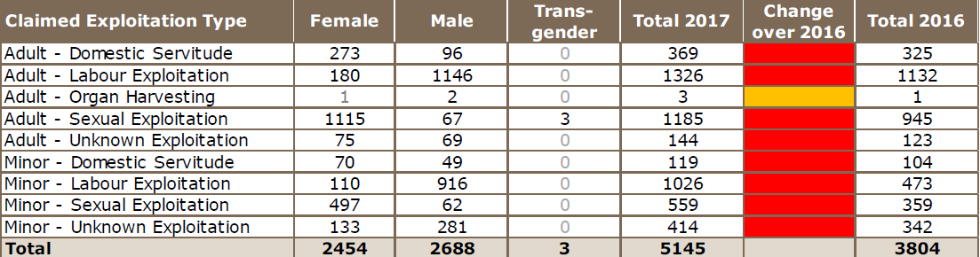
UK NRM Data 2017

Slide 29
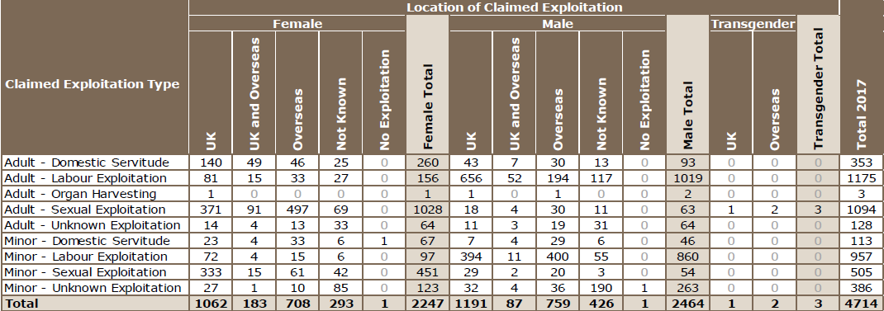
England NRM Data 2017

Slide 30
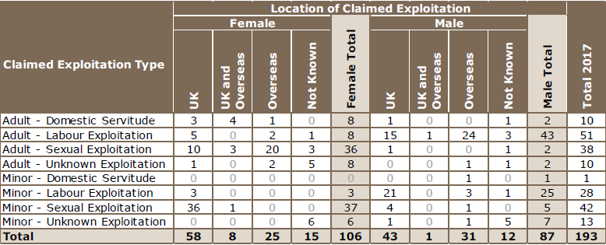
Wales NRM Data 2017
Notes:
The top 6 countries were Vietnam / Eritrea/ Nigeria/ Sudan / UK / Albania

Slide 31
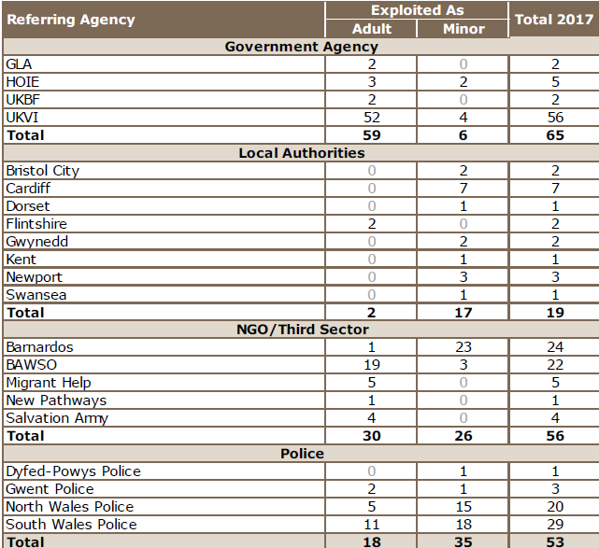
Wales - Referring Agency Totals 2017

Slide 32
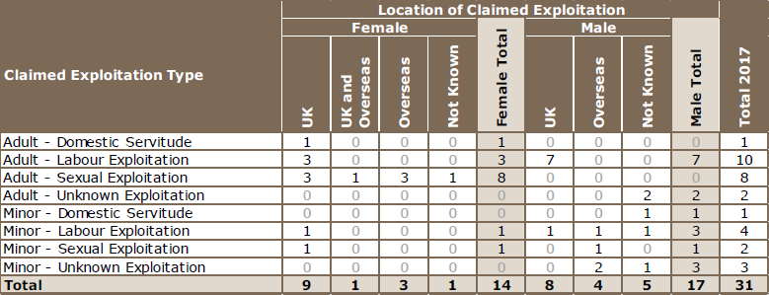
Northern Ireland - NRM Data 2017

Slide 33
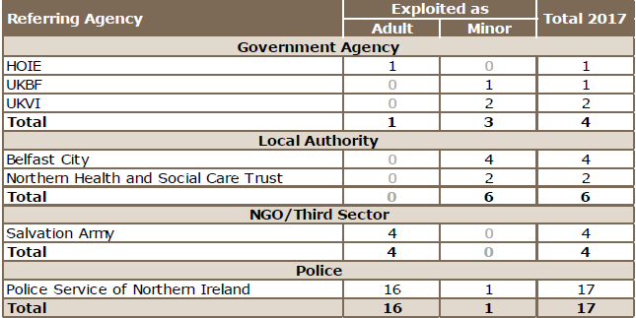
Northern Ireland - Referring Agency Totals 2017

Slide 34
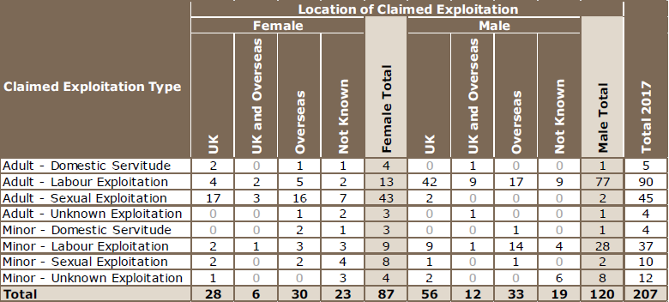
Scotland - NRM Data 2017

Slide 35
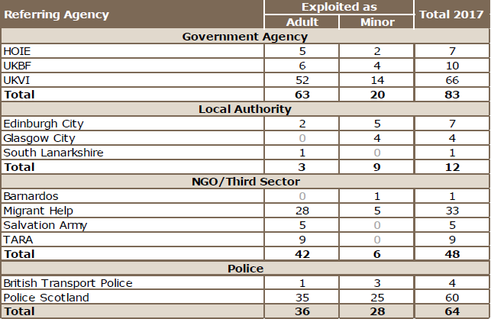
Scotland - Referring Agency Totals 2017

Slide 36

WHAT DO I DO IF I HAVE CONCERNS?
Question relationships
Look to gain trust and confidence if possible
Identify the risk
Safeguard all potential victims
Do not cause any unnecessary stress or re-traumatise
Empower/enable victim to make an informed decision (adults must consent to going into the NRM)
In all cases, trust and act on your professional instinct that something is not quite right!
UK Modern Slavery Training
Delivery Group
Notes:
Not all delegates will be in a position to gain trust or confidence in a situation so these are examples of what to do dependant on audience

Slide 37

VULNERABILITY
Being susceptible to harm or injury
Modern Slavery offences are about power, control and money
There are often multiple offenders who abuse or exploit a one or more victims
Notes:
There are many ways that a child or adult can be Vulnerable. This is not just about Modern Slavery, but also Child Sexual Exploitation, Domestic Abuse, Female Genital Mutual, Forced Marriage, Mental health, Prostitution and all aspects of Public Protection
The offences are about Power, Control and Money. It requires one or more offender to abuse or exploit one or more victims

Slide 38
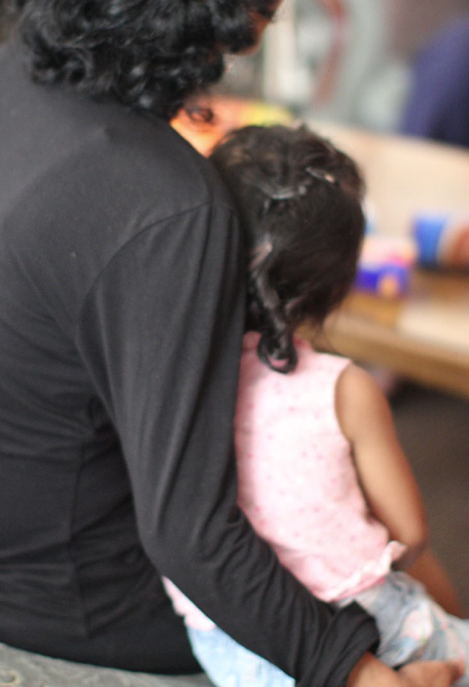
WHAT TO LOOK OUT FOR...
Perpetrators of Modern Slavery offences use power and control to exploit their victims. Ask the questions; yourself the questions;
What is the relationship between the offender and the victim?
What are the circumstances that contribute to a person being a victim?
What does an offender gain from the relationship?
How is the victim being controlled?
Has the victim been forces to commit crimes ?

Slide 39
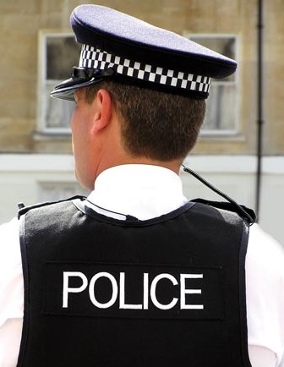
POTENTIAL VICTIMS
If in doubt, treat as a victim first:
Priority
The safe recovery of the potential victim is essential – contact the authorities
Secondary
Immediate risk of harm Dial 999
Advice and Guidance –
Modern Slavery Helpline 08000 121 700
Notes:
Crimes committed by the victim should also be secondary.

Slide 40

“SLAVERY TAKES PLACE IN YOUR COMMUNITY AND CAN BE STOPPED BY THE COMMUNITY”
WE CAN ALL WORK TOGETHER TO STOP IT!

Slide 41
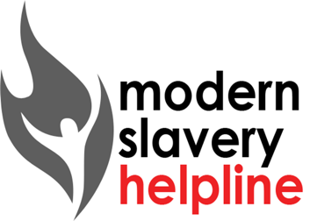
Modern Slavery helpline
Modern Slavery Helpline:
08000 121 700
Notes:
March 2017 figures
252 Calls into the helpline – 08000 121 700
50 Online Reports - www.modernslaveryhelpline.org
221 Cases
67 Cases of Modern Slavery

Slide 42
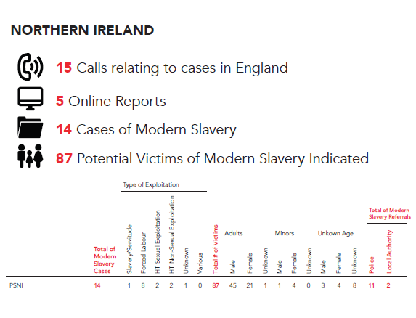

Slide 43
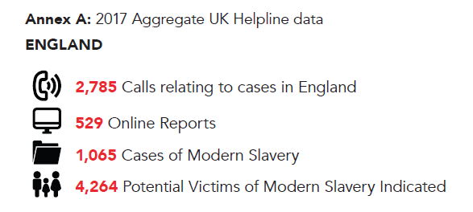

Slide 44
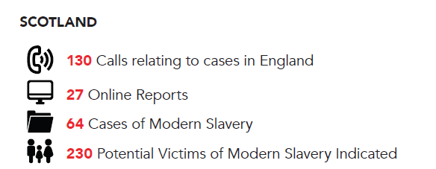

Slide 45
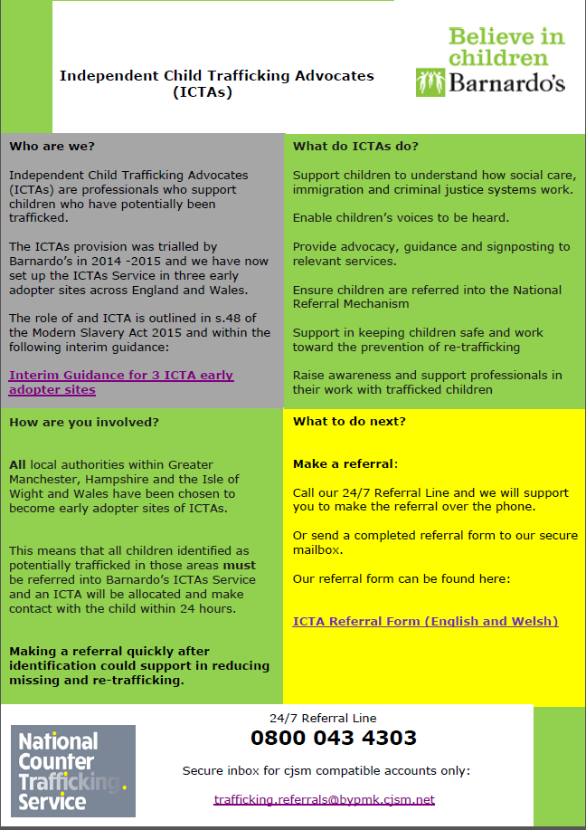
Notes:
Independent Child Trafficking Advocates are being piloted across Greater Manchester, Hampshire and the Isle Of Wight and Wales

Slide 46
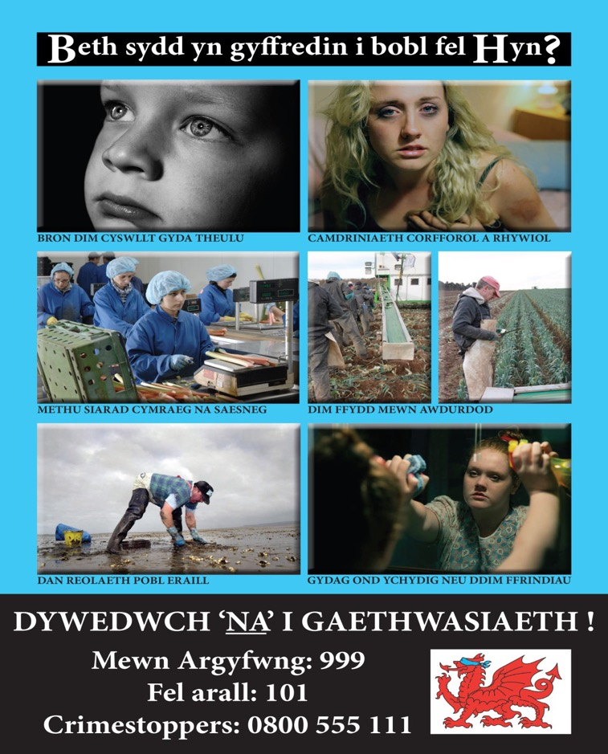
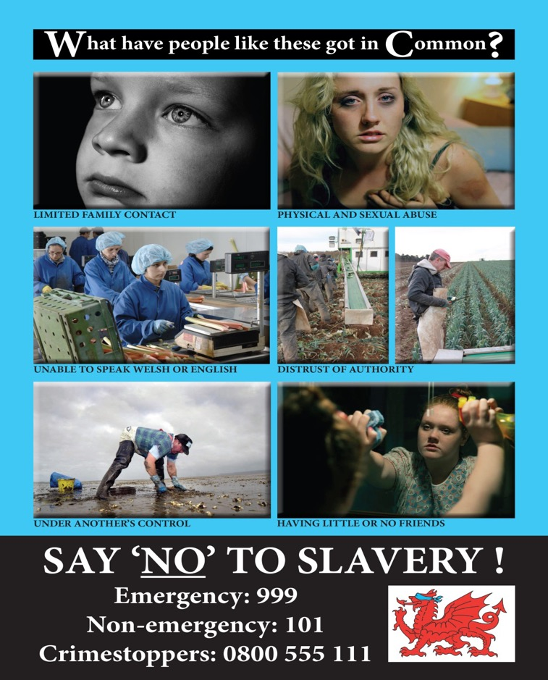
Notes:
These slides are intended to highlight the impactive use of images. There is however, no generic image of a trafficked victim and they don’t have labels saying they’ve been trafficked

Slide 47
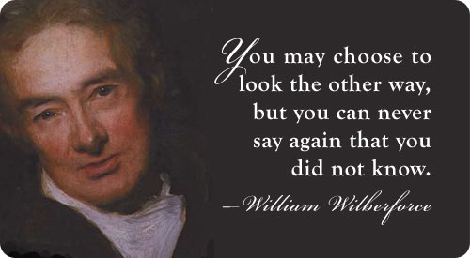
A SIMPLE MESSAGE
LOOK, HELP & UNDERSTAND
All public sector
Private sector
Third sector
Communities
“We all have a duty to prevent modern slavery” – Kevin Hyland, Anti-slavery Commissioner
Notes:
Look , help and Understand are all key points to remember for dealing with any one that is vulnerable

Slide 48


Thank You
Any questions ?
UK Modern Slavery Training
Delivery Group
Notes:
Any questions??

Slide 49
Training created by UK Modern Slavery Training Delivery Group
A21
Anti Slavery Commissioner Office
Barnardos
Bedfordshire Local Authority
Border Force – Home Office
Crimestoppers
Crown Prosecution Service – Wales
Department of Work and Pensions
Derby University
ECPAT UK
GLAA
Hibiscus (prisons)
HM Revenue and Customs
Hope for Justice
Human Trafficking Foundation
IOM International
Modern Slavery Helpline
Modern Slavery Unit – Home Office
National Crime Agency
NHS England
Northern Ireland Department of Justice
Welsh Government
NWG Network
Public Health England
Red Cross
Salvation Army
Scottish Government – Human Trafficking Team
SERCO
Sarah-Jane Prew – Aviation Security Specialists
Unchosen
Unseen
West Midlands Anti-Slavery Partnership
“We are Modern Slavery and Human Trafficking victims’ only chance of freedom” Kim Ann Williamson MBE 2017

